Slide 1

Wrapped Now
ITWS Group 20 - Robert Acebedo, JJ Whitehurst, Andrew Jung

Slide 2
Team 20
Andrew
Robert
JJ
HTML and CSS for the web pages.
Designed the frontend
Implemented JavaScript and jQuery for user interactivity
Parsed JSON returned from API calls
Used PHP to make the Spotify API calls
Used PHP to allow user authorization
Gets user Spotify data based on inputs

Slide 3
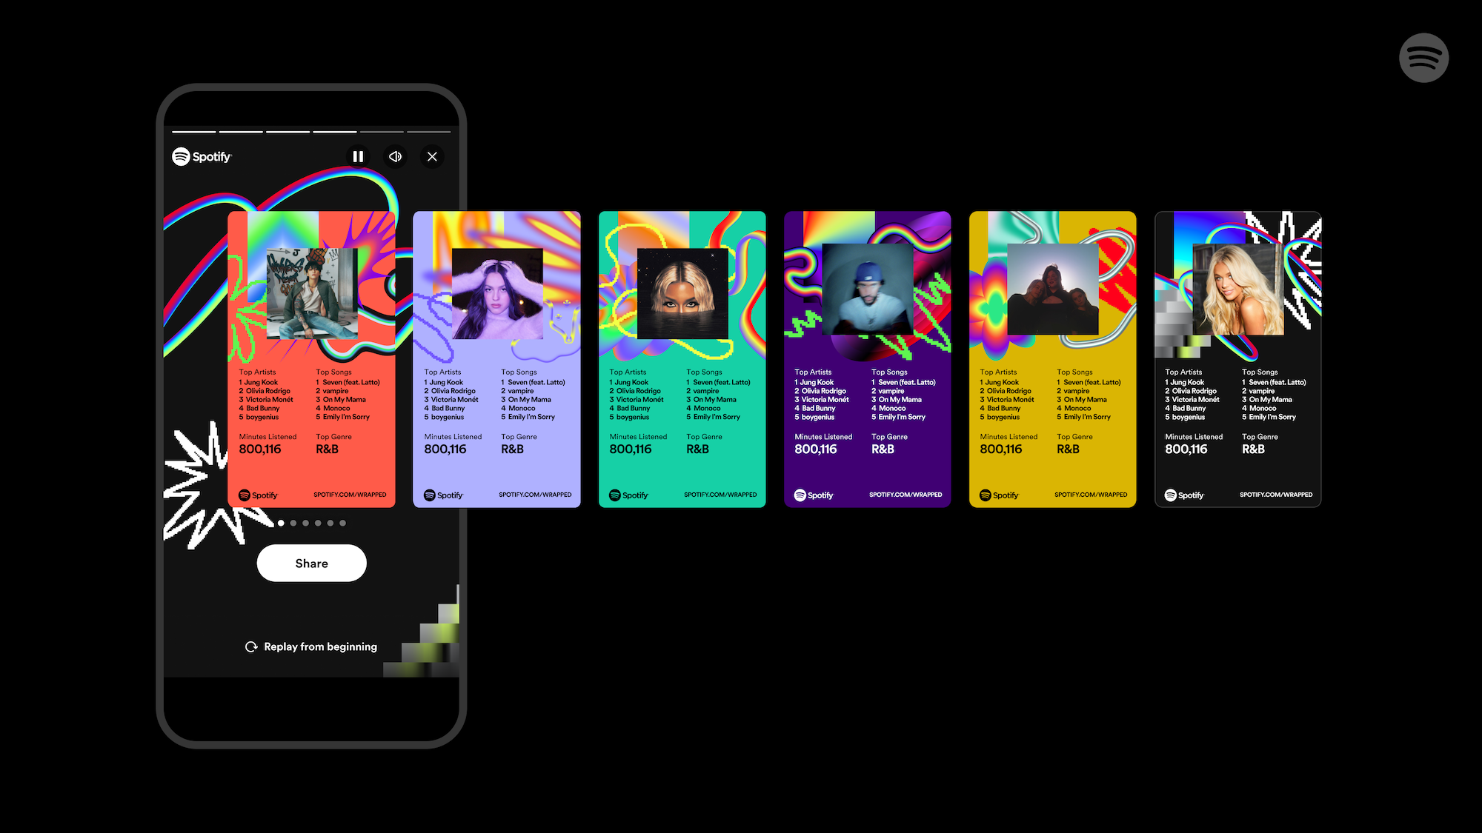
What is Wrapped Now
Main Objective: Allow a spotify user to access their top listening data anytime and accurately.
Improves on Spotify’s yearly Wrapped
Creates an infographic to be shared with real time listening data.
Uses Spotify Web API

Slide 4
Core Features
User Login
Retrieve Data
Login in through Spotify which allows us to retrieve access token to make API calls.
Listening data is retrieved through the Spotify Web API and displayed to the user as top 5 songs and artist in certain time periods that are specified.
Customization
Stats Page
Users are able to customize the graphic showing their listening data through changing the color and time period to display.
Users can view a list of their top 50 artist/songs for a time period specified (last month, last 6 months, last year)

Slide 5
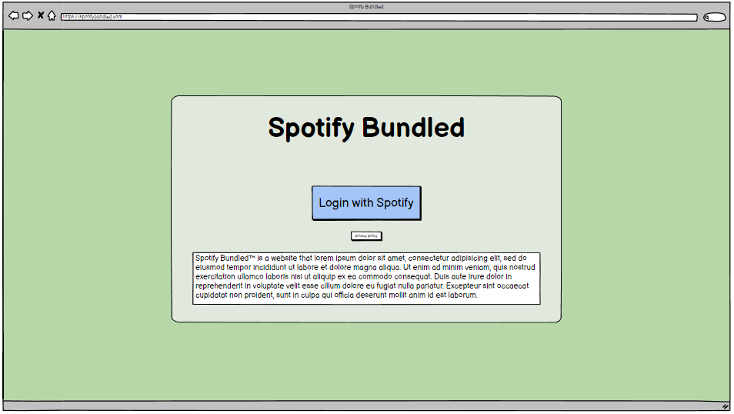
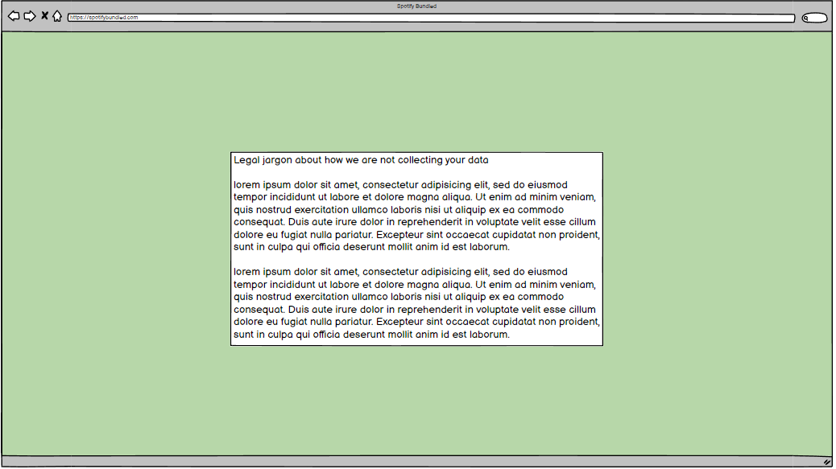
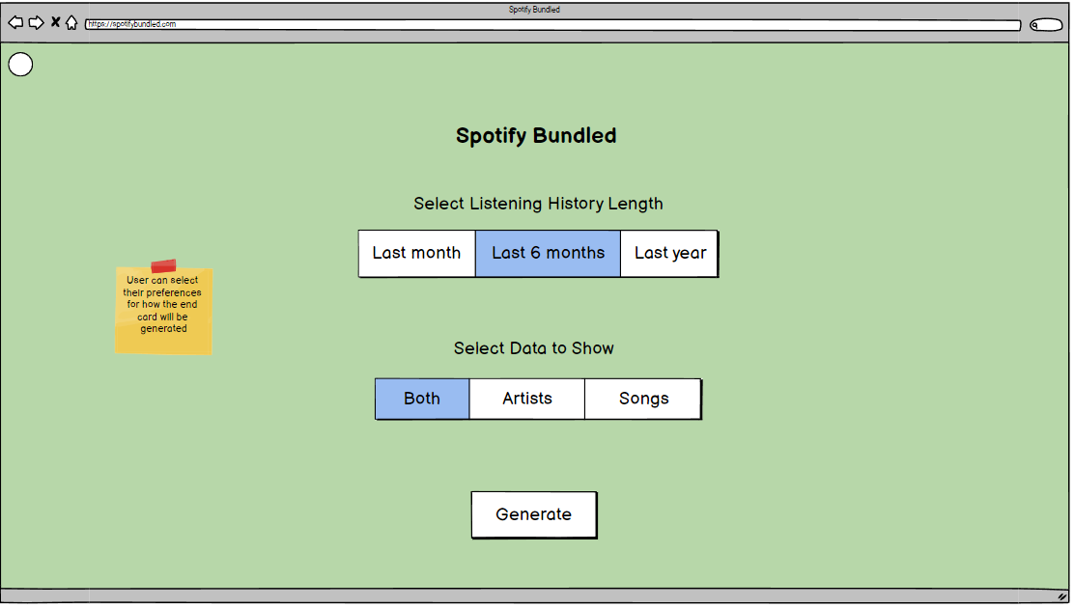
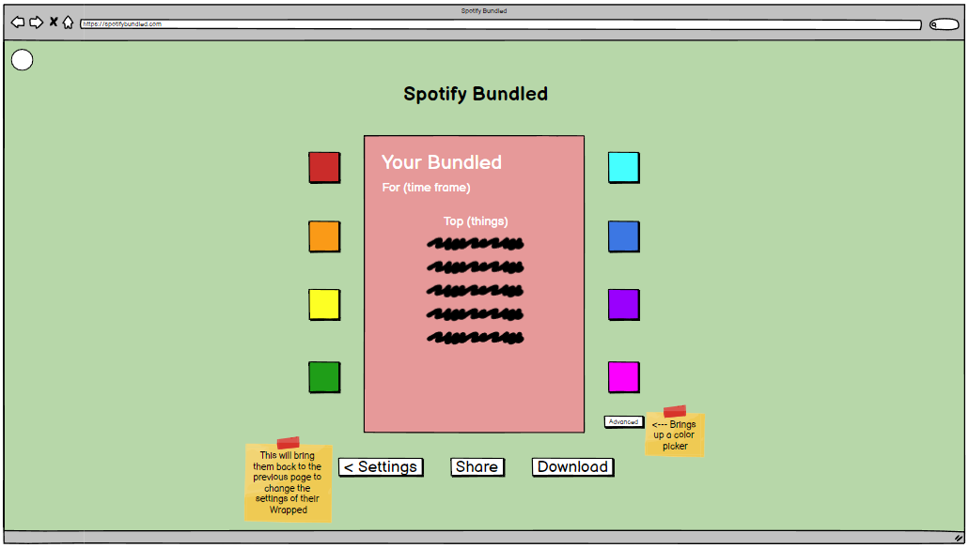
Wireframes

Slide 6
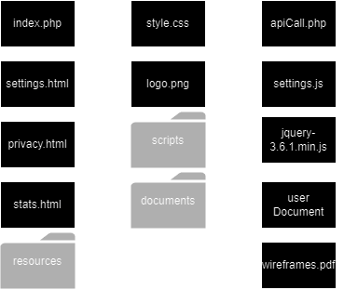
Information Architecture
All pages are held in the root directory
Css and js files are held in resources folder

Slide 7
Focus Areas
Area 1
Area 2
JavaScript interactivity to improve user experience
Customizations through color picker
Dropdowns for user input
Pull static data from a JSON
Spotify API returns JSON
JSON needs to be parsed
After parsing, create HTML to display data

Slide 8
User Personas
John Listener
Jane Sharer
Age: 26
Occupation: Data Scientist
- Avid Spotify listener and general music enjoyer
- Just started listening to a new genre of music
- Wants to show listening habits to friends
- Curious about data that Spotify stores on users
Age: 19
Occupation: Student
- Always active on social media
- Loves to share things with followers and friends
- Missed Spotify Wrapped last year as she just signed up for Spotify

Slide 9
Challenges We Faced
Limitations of Vanilla JavaScript
JSON Parsing
PHP and OAuth 2.0
Spotify API returns massive JSON
Sifting through the key-value pairs
Getting the data required accessing many nested arrays
Challenged with merging PHP and JavaScript
AJAX was the only way to access PHP scripts through client side
Tedious to test
Bugs in obtaining access token
Inexperienced PHP coder

Slide 10
Demonstration

Slide 11
Future Plans
Ability To Share
More User Customization
Limitations prevented us from implementing the ability to share the card.
Add more ways for users to customize their card.
Give users the chance to personalize their cards further.

Slide 12
Thank you

